Slide 1
Android 101
Zaki Anwar Hamdani

Slide 2
About Zaki
Java Developer
Has spend over seven years in Banking and Financial Services industry
Passion for learning

Slide 3
Before Android
Embedded Programming
Hardware Dependant
J2ME
Symbian
iOS

Slide 4

What is Android?
Operating System from Google
Open source
Linux based
Intended for mobile computing platforms
It is the world's most widely used Smart Phone platform since Q4 2010

Slide 5
What It is NOT
Not J2ME extension
Simply an Application Layer
A mobile phone handset
Google’s answer to iPhone !!!

Slide 6
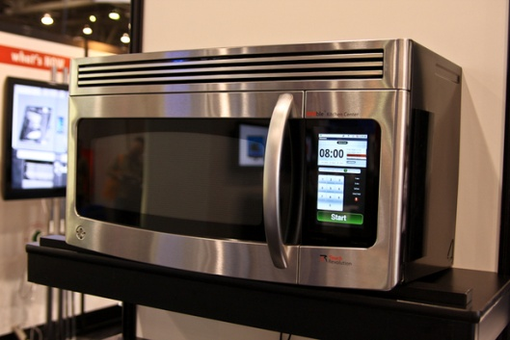
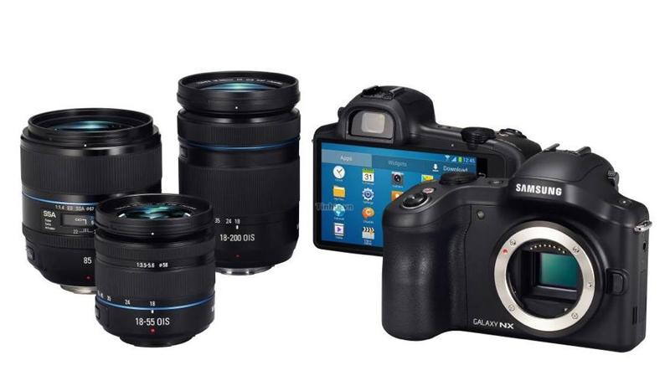
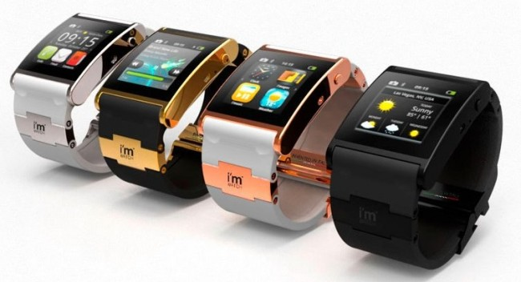
Why Learn it
Newness
Coolness
Googleness
Javaness
Universalness
Future of all devices
Android went ahead of
Apple in Apr’13 with 51.7%
market Share

Slide 7
Android SDK
Stands for Software Development Kit
It’s free
Contains API for App Development
API for telephony like GSM, EDGE, 3G and Location
IPC Message passing
Graphics Library OpenGL ES
Integrated with Eclipse

Slide 8
Love IntelliJ IDEA?
It recently added full-cycle Android development support in both the free Community Edition and the Ultimate edition
The IDE ensures compatibility with the latest Android SDK and offers a smart code editor with completion, quick navigation between code and resources, a graphical debugger, unit testing support using Android Testing Framework, and the ability to run applications in either the emulator or a USB-connected device.
http://developer.android.com/tools/workflow/index.html

Slide 9
Do You need phone?
Not Really
Though little slow, but an emulator that is part of the Android SDK can be used for development.
(Google has earelier distributed free phones to developers fulfilling certain criteria)

Slide 10
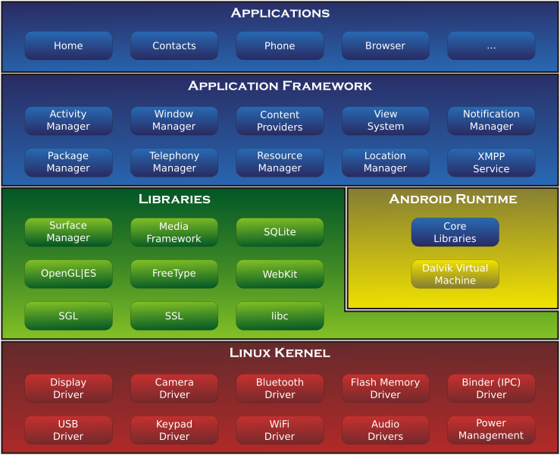
Architecture

Slide 11
Framework Layer
Feature | Role
View System | Used to build an application, including lists, grids, text boxes, buttons, and embedded web browser
Content Provider | Enabling applications to access data from other applications or to share their own data
Resource Manager | Providing access to non-code resources (localized strings, graphics, and layout files)
Notification Manager | Enabling all applications to display customer alerts in the status bar
Activity Manager | Managing the lifecycle of applications and providing a common navigation back stack.

Slide 12
Developer Perspective
Activity
Service
Broadcast receiver
Content provider
Intent
AndroidManifest

Slide 13
Activity
Similar to a Use Case.
Represent one thing (Activity) that user an do.
A typical application may have multiple Activities.
Each Activity extends android.app.Activity class
Each Activity has a window to draw contents.

Slide 14
Service
No Visual interface
Runs in background
Examples are Downloading, Playing Music etc

Slide 15
Broadcast Receiver
Extend the class android.content.BroadcastReceiver
It receives and (may) react to broadcast announcements.
For Example, Low Battery, Time zone changed etc.

Slide 16
Content Provider
Used to interchange data between different Applications
This is only way to exchange/transfer data between different Apps, that is, no shared memory, no shared files etc

Slide 17
Intent
An Intent to start either an Activity, Service or Braodcast Receiver

Slide 18
AndroidManifest.xml
Package and Version
SDK
Application
Activities
Permissions

Slide 19
<?xml version="1.0" encoding="utf-8"?>
<manifest xmlns:android="http://schemas.android.com/apk/res/android"
package="org.melbjvm.android"
android:versionCode="1"
android:versionName="1.0" >
<uses-sdk
android:minSdkVersion="8"
android:targetSdkVersion="17" />
<application
android:allowBackup="true"
android:icon="@drawable/ic_launcher"
android:label="@string/app_name"
android:theme="@style/AppTheme" >
<activity
android:name="org.melbjvm.android.MainActivity"
android:label="@string/app_name" >
<intent-filter>
<action android:name="android.intent.action.MAIN" />
<category android:name="android.intent.category.LAUNCHER" />
</intent-filter>
</activity>
</application>
<uses-permission android:name="android.permission.SEND_SMS" />
</manifest>

Slide 20
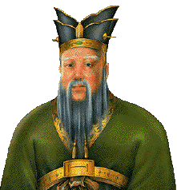
What Next???
Confucius said….
“I hear and I forget,
I see and I remember,
I do and I understand.”
So let us do it……

Slide 21
What we will do
Create simple Android App and run it on Emulator
Run the same on your phone
Use a simple Web Service in our App
Use Simple Graphics

Slide 22
Starting with SDK
Download from
http://developer.android.com/sdk/installing/index.html
It uses Eclipse IDE and its Cool!!!

Slide 23
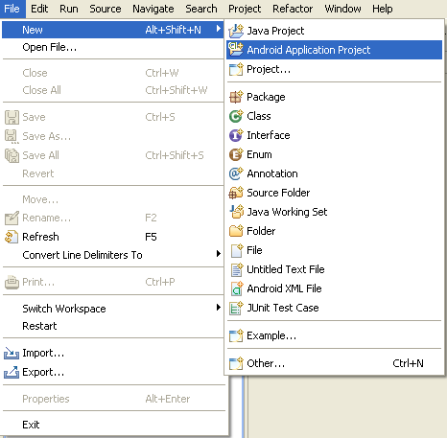
Creating First Android App

Slide 24
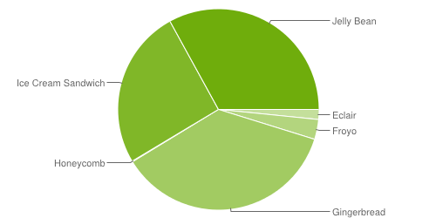
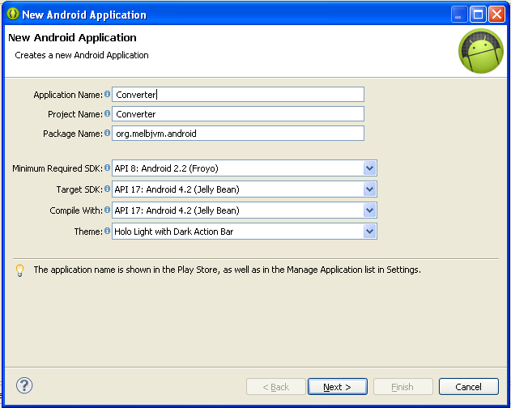

Slide 25
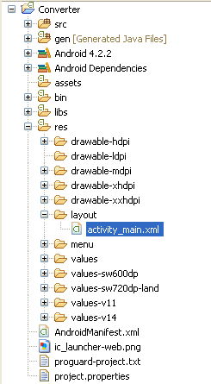

Slide 26
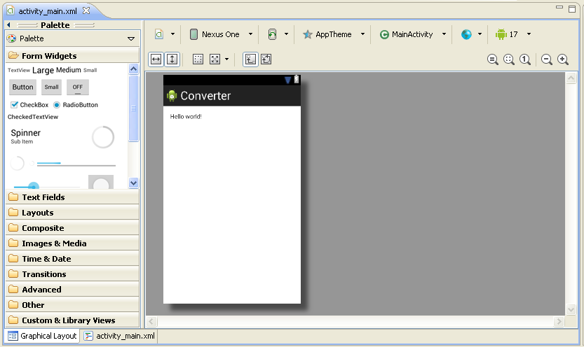

Slide 27
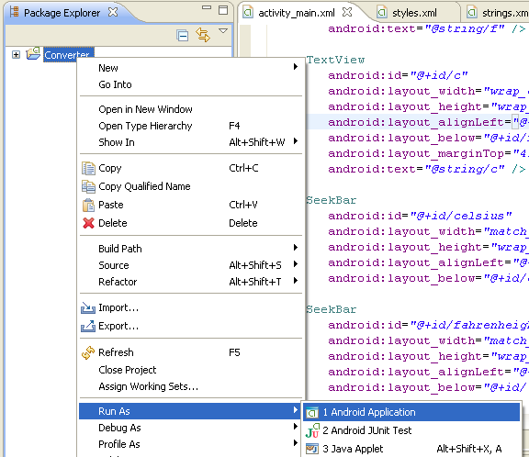

Slide 28
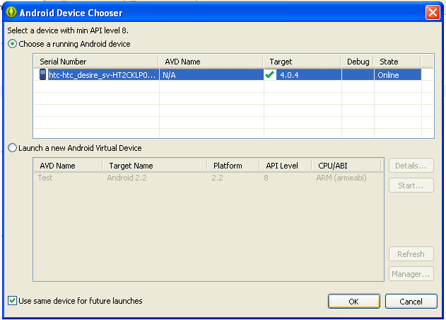

Slide 29
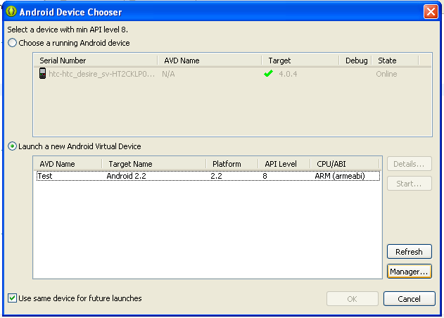

Slide 30
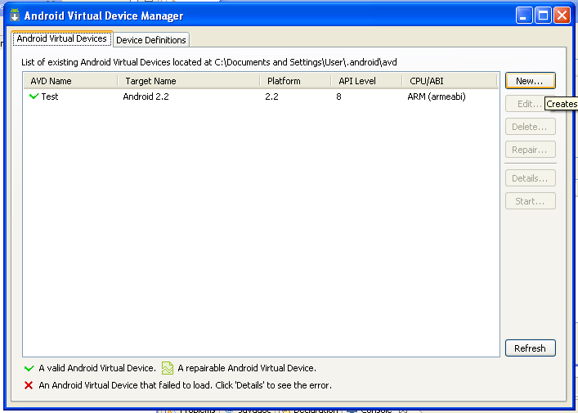

Slide 31
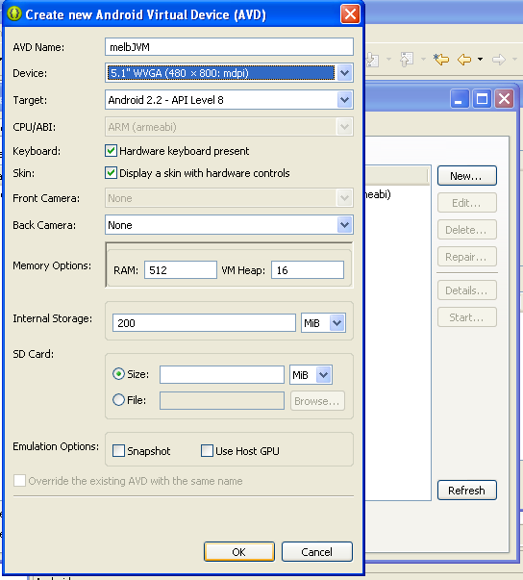

Slide 32
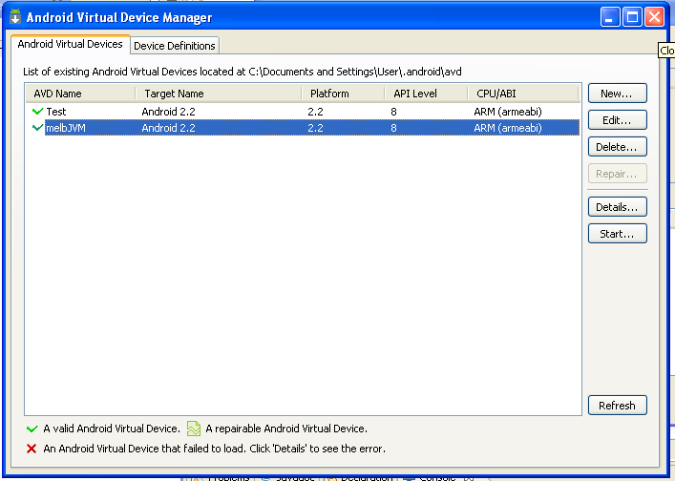

Slide 33
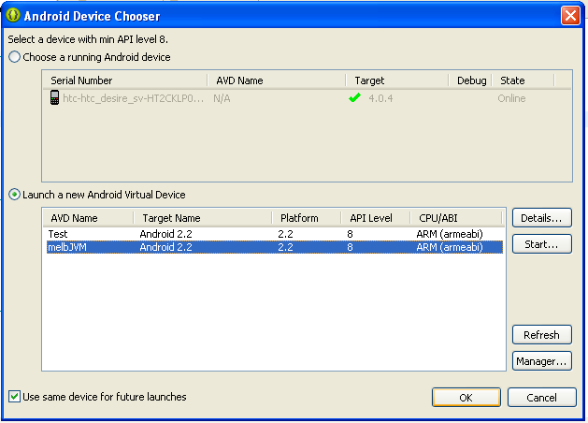

Slide 34
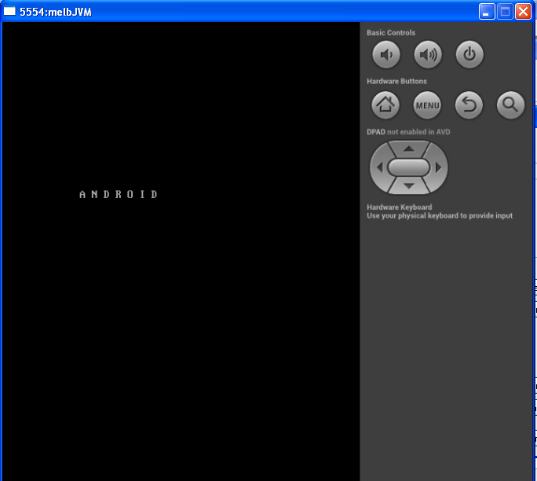

Slide 35
Questions and Answers

Slide 36
Further Help
http://developer.android.com
http://code.google.com/p/apps-for-android/
http://developer.android.com/design/index.html
http://www.kantarworldpanel.com/Global/News/While-Android-Leads-iOS-and-Windows-Are-Growing-At-A-Faster-Pace

